Slide 1
Machine Reading:
Goal(s) and Promising (?) Approaches
David Israel
AIC, SRI International (Emeritus)
DIAG, Sapienza (Visiting)

Slide 2
DARPA’s Vision
“Building the Universal Text-to-Knowledge Engine”
“A universal engine that captures knowledge from naturally occurring text and transforms it into of the formal representations used by AI reasoning systems. “
“Machine Reading is the Revolution that will bridge the gap between textual and formal knowledge.”
That is how the Program Manager for DARPA’s Machine Reading Program described the goal of the program – both to us researchers and to his superiors at DARPA.

Slide 3


Slide 4

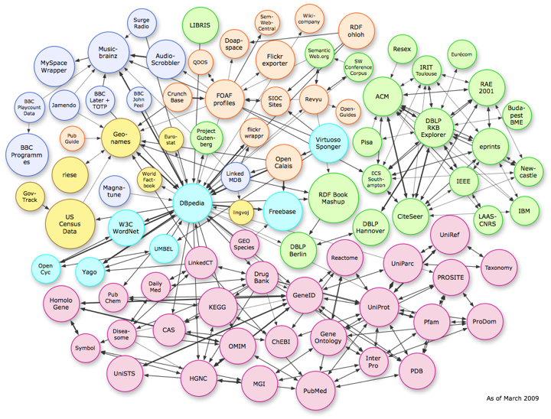
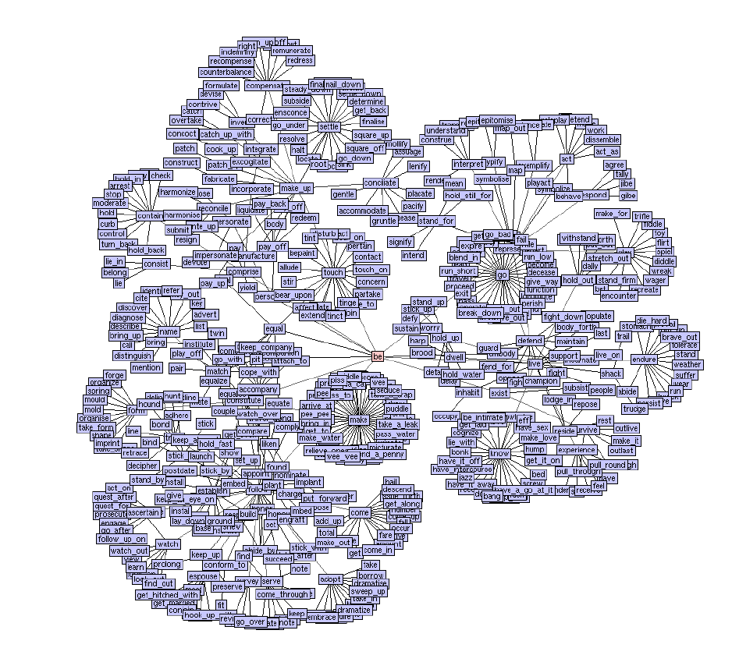
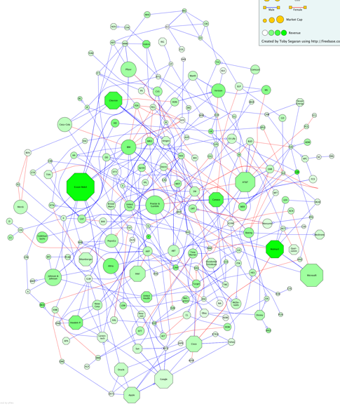

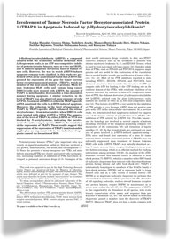


The goal of Machine Reading:
From “Unstructured” Text to Knowledge
Knowledge Representation and Inference

Slide 5
The Scope of the Vision …
Made More Real(istic)
Let’s focus on texts in one language, say English
  So we’ll drop talk of “universality”, whatever such talk was supposed to mean
Let’s focus on texts that are intended to be informative and at least present themselves as trying to communicate only truths (that is, only propositions that the author believes to be true)
  So, no Proust, no Italo Calvino, no Shakespeare, etc. etc.
  Also, no Yelp! No movie reviews, no opinion pieces, etc. , etc.
Also (in case this doesn’t follow from the above), let’s focus on texts in which there is only one “anonymous speaker/writer” (so no dialogue-heavy texts), communicating with an “anonymous public”
  So no letters, personal emails, etc.
Prime examples: news stories; scientific articles

Slide 6
Question-Answering as a Test of Understanding
One way to determine whether an agent has understood a text is to ask the agent questions “about” the text.
Sure, but … ability to answer correctly has to be in some sense dependent on the understanding
  I give you a text in Quantum Field Theory, which happens to mention the shape of the Earth and ask you, “What is the shape of the Earth?”
The idea, roughly, is: Agent α wouldn’t have been able to answer the question if α hadn’t understood the text.
  The idea isn’t: α would not be able to answer the question unless he had read that particular text; and moreover, that text contains all the information α has/had access to
This idea is not easy to make completely precise
Explains (partially) use of Reading Comprehension tests whose texts are simply made-up just for the purpose of testing comprehension.

Slide 7
Ability to Translate
Another way to demonstrate understanding is to translate a text into some other language
  This can’t be a necessary condition
  Else, I wouldn’t be seen to understand a single text!
The idea: a good translation of a text renders the informational content of the original into the target language.
  The translation of the text should “say the same thing” as the original – have (roughly/essentially) the same informational content
  So, the translator must have “grasped” that informational content
  But again, there is no requirement that the translator has no extra-linguistic information beyond what the original text expresses

Slide 8
The Structure of the Evaluation
The test for understanding in MRP involved two steps:
First, translate the English text into a formal representation language
Then, query the resulting “KB”, with questions that the system would be unlikely to be able to answer unless it had understood the text, that is, correctly translated it into its native tongue.
  But again, there was no restriction on what other information the system might have access to
In what follows, we will stipulate that that native tongue can be thought of as a first-order language, perhaps with probabilistic extensions. Let’s call this family of languages P-FOL
  SO the resulting KB is a set of sentences (closed wffs) in a P-FOL
  Just to be clear: The “P” might be a no-op, that is, FOLanguages are to be considered as included de jure
Keep in mind: we have simply fixed the form(at) of the desired, query-independent (task-independent??) output of reading

Slide 9
Formal representations used by AI reasoning systems “Islands of Formal AI Knowledge”
Example Target Formalisms:
  (Relational) Database Systems
  Datalog / Logic Programming formalisms
  OWL and other Description Logics
  Bayes’ Nets
  Probabilistic DBs
  First-order languages
  Higher-Order and/or Modal/Intensional Languages
  Probabilistic Relational Languages
  Probabilistic extensions of higher-order or …

Slide 10
What these have in common
At least 1 explicit and (mathematically) precise semantic account
  Typically defined via an inductive definition over the syntax of the formalism
Which supports -- makes sense of and justifies – at least one precisely defined deductive system, such that
One can determine when a candidate inference is made in accordance with the rules of inference of that system
One can prove that those rules make sense (are sound, goodness-preserving), relative to the semantic account
This all gets (even) a little more complicated if the formalism is probabilistic, as we have to figure out what property of sentences “valid” inferences should preserve.

Slide 11
(P)FOLs as Universal
MRP did not want to restrict, in any way, the approaches that the (3) teams took
In particular, did not want to restrict the “native data structures”, including representational structures used
But what was required was that there be a “canonical output” algorithm, transforming internal representational structures into a formal representation language with a well-understood mathematical semantics
And there are grounds for stipulating that FOLanguages are, for many purposes, universal among such languages.
Anything that can be said in any one of them, can be said (if not especially naturally) in a first-order language

Slide 12
A Brief Digression on the Goals and Methodology of AI
AI is not an empirical science
  So it matters not at all whether people on reading do – unconsciously -- anything like this “translation”, nor what the target representation formalism, if there is one, is like
But it is also not a purely mathematical discipline
  It is not a branch of mathematical logic or statistics/probability theory
It is a design discipline
Its goal: to design and build systems that act intelligently
In particular, it is not a part of Cognitive Psychology
But it can learn things from Cognitive Psychology
  And from Physics and Biology and … Logic and …
And it can teach things to Cognitive Psychology
  And maybe to Biology and to Logic, but probably not to Physics
End of Digression!

Slide 13
FAUST
SRI led a large team under the title
Flexible Acquisition and Understanding System for Text !
Team:
  SRI (yr. hmbl svt)
  MIT (Michael Collins)
  (Xerox) Parc (Anne Zaenen, Danny Bobrow)
  Stanford (Chris Manning&Dan Jurafsky, Andrew Ng)
  Univ. Of Illinois (Dan Roth)
  Univ. of Massachusetts (Andrew McCallum)
  Univ. of Washington (Pedro Domingos, Dan Weld)
  Univ. of Wisconsin (Jude Shavlik, Chris Re)

Slide 14

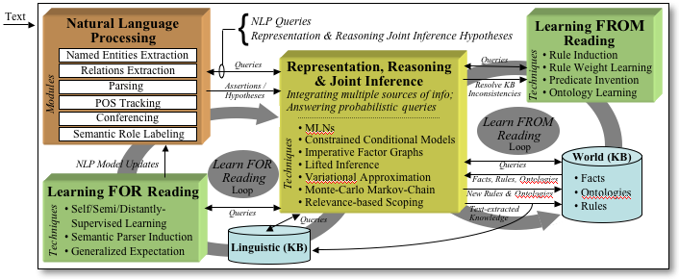

Machine Reading
09-03
Flexible Acquisition and Understanding System for Text
SRI’s FAUST Reading System
Machine Reading via Machine Learning and Reasoning: JOINT INFERENCE
Main Objective
To make the knowledge expressed
in Natural Language texts usable by computational reasoning systems
Learn new
concepts and
rules by reading
Integrate information
across multiple texts
Set of knowledge and context-aware
NLP tools capable of extracting linguistic representations and hypotheses from raw text
Make use of rich non-linguistic knowledge
sources
Manage large-scale heterogeneous, probabilistic joint inference
Learning enables continuous improvement in reading
FAUST's unique Joint-Inference architecture, integrating NLP, Probabilistic Representation & Reasoning and Machine Learning, enables revolutionary advances in Machine Reading
Expected Impact
Key Innovations and Unique Contributions
Knowledge-aware NLP architecture leverages a wide range of evidence (linguistic and non-linguistic) at all levels of processing
Identify and interpret discourse relations between sentences, gather information distributed over multiple texts, and use sophisticated Joint Inference over partial representations to integrate this information into one coherent model
Develop a set of innovative localization, factoring, and approximate inference techniques, in order to efficiently coordinate ensembles of tightly linked information sources
Use a set of concept- and rule-induction mechanisms to learn both new concepts and refine existing ones from natural text
Joint Inference applies previously learned knowledge to continuously improve reading performance.
We will deliver FAUST (open source), a breakthrough architecture for knowledge- and context-aware Natural Language Processing based on Joint Inference.
FAUST will exponentially increase the knowledge available to knowledge-based applications.
Notes:
"FAUST embodies an integrated approach based on joint inference that provides the functional capabilities needed to produce a universal reading system. Four unique and tightly-integrated functional elements of FAUST are highlighted in the diagram: (a) a set of knowledge and context-aware NLP tools; (b) a representation, reasoning and JI mechanism for combining heterogeneous and uncertain hypotheses from both linguistic and background knowledge sources; (c) a set of ML components for improving the performance of NLP modules over time; and (d) a set ML components for generalizing the information acquired from reading and adapting to new domains."

Slide 15
Huh?
That last slide was the official, DARPA-approved and DARPA-formatted slide “introducing” the FAUST Team to the Machine Reading Program, for the Program Kick-off in September, 2009.
Allow me to explain …

Slide 16
The BaseLine Picture:
The Standard/Stanford NLProcessor
Let’s start with the sentence!
A sentence is at the very least a sequence of words
  And there surely is something significant about the sequence
  There surely is some “underlying” structure – syntactic structure!
The meaning of a sentence is determined by the meanings of the constituent words and the syntactic structure(s) in which those words are combined
  Roughly, Frege’s functionality principle
This together with “the facts” suggests the possible applicability of a pipeline approach like the following, to one sentence-at-a-time processing:

Slide 17
Stanford’s Baseline NLProcessor
Tokenization
Annotation
Object
Sentence Splitting
Part-of-speech Tagging
Free
Text
Morphological Analysis
Execution Flow
Named Entity Recognition
Annotated
Text
Syntactic Parsing
Semantic Role Labeling
Coreference Resolution

Slide 18
The “Facts”
We’re talking about machine processing of on-line (digitized) text, so no possibility of detection or recognition error at the character level, but
Tokenization:
  Grazie mille for spaces between words in English! Still, …
  Machine has to handle punctuation, hyphens, multi-word units
    Roberto’s ; don’t ; and/or
    State-of-the-art
    Maria Teresa Pazienza ; Roma, Italy ; lunedi 14 dicembre 2015
Morphology
  “run/runs/running/ran” ; “destroy/destruction”
Intrasentential co-reference resolution
  Pronouns (“he”, “hers”, “it”, …)
  “aliases”: “Dr. Israel …..; and then David ….”
  And the rest: “Roma …..; and the capital of Italy …”

Slide 19
Simple Observations
The pipeline doesn’t directly perform any end-user oriented tasks, e.g., question-answering or recognizing textual entailment. Nor does it
Output representations in P-FOL
Rather, its aim is to provide all (?) the more-or-less purely linguistic information needed to perform those tasks.
For standard NLP tasks: that is all the information required
  Coreference?? Purely Linguistic?? Nah!
  What/Where is the boundary between linguistic and non-linguistic sources of information?

Slide 20
Pipeline Architecture For MR:
Summary
A sequence of “black-boxes”, each one passing along its results to the next module
  1-best
  N-best
  Partial order
  Maybe even a probability distribution
No feedback from later modules to earlier, etc.
Its final output is input to ….?

Slide 21
If It All Worked
Final output would be a representation of the meaning of a sentence as determined by the meanings of its constituent words and the syntactic structure of the sentence
In the idealized extreme:
  Where f_{syn} is a syntactic function representing the modes of combination of the words/phrases, given their syntactic types, such that when applied to those types, f_{syn} yields an entity of syntactic type S
  There is a corresponding semantic function f_{sem} that for the semantic types of the words/phrases as arguments yields a semantic entity of the type Prop
IF ONLY !!

Slide 22
What History Has Taught Us
We -- and the systems we can build – do not know enough to succeed in this strictly pipelined fashion
First, many of the decisions our systems make are – and should be treated as – uncertain and if forced to make a choice among alternatives, they will often make the wrong one
Second, such errors tend to cascade and accumulate
But third, often there is evidence relevant to decisions at stage n that only becomes available at stage n+m
And maybe we shouldn’t be forced to make a definite choice too early

Slide 23
One “Point” in a Space
We could support joint inference among such NLP modules
And we did!
Drawing on a large body of work by our team and others
Prime example: joint modeling / joint inference as between named-entity recognition and parsing improves performance on both tasks.
  Finkel & Manning, NAACL, 2009

Slide 24
Joint Parsing and Named Entity Recognition Helps on Both Tasks

Slide 25
The Space of Architectures
Global
Evidence
Fusion
high
World Knowledge
and Linguistic Evidence
Fusion
“One big engine”
Use of available information
World Knowledge Fusion
Linguistic Evidence
Fusion
Limited NLP JI
“Pipeline”
Modular Decomposition
low
high
efficiency

Slide 26
Another Point in the Space
The “Hobbs” picture (“Interpretation as Abduction”)
Every kind of information is represented in a single, uniform way
A single reasoning engine manipulating all such representations
Our re-interpretation: the representation language is a first-order language, over whose models a probability distribution is defined
  Here we deviate sharply from Hobbs et al., by sketching a fairly precise probabilistically-based formalism
Like the language of Markov Logic Networks (Domingos)
Each wff of the language of MLNs is a pair consisting of a wff of an FOL and a weight (representing a probability)

Slide 27
The Fully Extreme Picture
Single, extremely expressive language
Full P-FOLs
  Probabilities/weights are part of the language
We can express
  Both categorical and statistical / probabilistic domain theories
  Statistical / probabilistic NLP theories
  bridge principles connecting domain and linguistic, e.g. lexical, knowledge

Slide 28
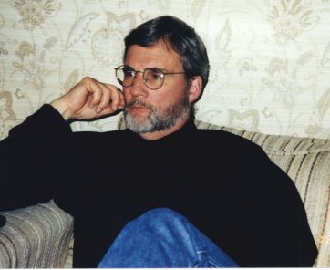
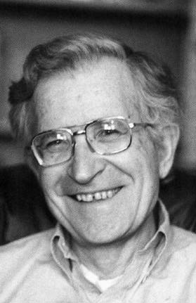
The Space of Architectures
Global
Evidence
Fusion
high
The Hobbs picture
“One big engine”
Fusion of World Knowledge
and Linguistic Evidence
Use of Totality of available evidence
Fusion of World Knowledge
NLP JI
Fusion of Linguistic Evidence
Modular Decomposition
Modularity

Slide 29
A Vision to Help Us Decide
Where In This Space to Aim For
Reading as a special mode of acquiring information (“knowledge”)
For the last 2,000 years, writing has been the dominant means of transferring knowledge among “non-intimates”, non-family&friends
Most of human knowledge is most accessible to other humans through written material
Some crucial things to remember are:
  A person brings background knowledge and beliefs to a new text
  A person (often) has a focus given by open questions/an information need, maybe just a mild interest
  A person integrates information across multiple sentences and texts
  A person combines mutually constraining information from multiple levels of linguistic analysis with existing knowledge
  But, typically, there is not much feedback from domain knowledge to the purely linguistic processing of the text, at least at sentence-level
  Only when the reading (= text-processing) hits a roadblock – some difficulty of interpretation

Slide 30
Why Not Put It All Together?
The Charms of Modularity
Put aside the armchair Cognitive Psychology
It’s all about Efficiency !!
We already have many distinct, well-conceived and well-engineered (procedural) NLP components/modules
Each of which represents an efficient mode of (linguistic) knowledge compilation
It would be crazy to throw these away!!
Moreover, joint probabilistic inference typically requires homogenous, declarative representations of all the random variables.
Including all the random variables involved in modeling the linguistic phenomena would add immensely to the overall computational problem
And for very little and infrequent gain

Slide 31
Yet Other Dimensions of Efficiency
Efficiency of Design and “Knowledge Acquisition”
  Specialized knowledge about special structures (algebraic/topological/ …) is often more naturally, compactly and usefully expressed in terms of algorithms over special data structures
  Graph-theoretic / tree-theoretic algorithms vs. proof in the (first-order) theory of graphs or trees, especially for special classes of graphs or trees
  Even more so: where the information has to be modeled probabilistically to account for uncertainty

Slide 32
The Space of Architectures
Global
Evidence
Fusion
high
The Hobbs picture
“One big engine”
Fusion of World Knowledge
and Linguistic Evidence
Use of Totality of available evidence
Sweet Spot??
Fusion of World Knowledge
Fusion of Linguistic Evidence
NLP JI
Modular Decomposition
Modularity

Slide 33
Our Final (?) Picture
Modularity at the level of NLP components, but
  With a mixture of joint inference among modules where beneficial
Final output of NLP is a probability distribution over full-sentence analyses
That is translated into input to a Probabilistic First-Order Reasoner, which also
Contains expressions of (typically uncertain) domain knowledge
For Joint Inference, where the NLP output is taken as uncertain evidence

Slide 34
The Final Word
The foregoing is a promising approach

Slide 35
Wonky Backup Slides

Slide 36
Reading as a special mode of acquiring evidence
Reading to Learn (for “adult readers”)
  Note: not learning to read!
  Guiding example: reading a scientific article in a field you already know something about
Subject brings background knowledge/beliefs (K) to the new text
  Much of this picked up from reading other texts
Associated with K is a set of (sets of) competing hypotheses, H: answers to still open questions
Given subject’s ability to read, K turns raw data (strings of characters) into evidence for/against various elements of H: sentences-as-interpreted
    Likelihood of e, given K + H _{i} / Likelihood of e, given K + H_{j}
    Bayes’ Factors
Major Twist: reading gives us access to much more than reports of observations/experiments!
We can also learn that e = mc²

Slide 37
Fairly Wonkish Stuff
Let’s start with a finitely axiomatized FO theory T, in L, over some fixed domain D of objects
To define a probability function PROB over wffs of L
  W, a set of indices of classical interpretations/models of L (“possible worlds” or states) -- “external probability”
    SO “modalized” constant-domain FOL
  <W, F, PROB> is a probability structure W
  M = <W, D, I> is a probabilistic model structure, I a set of FO interpretations of L
  Standard model theory– with interps indexed by W
    (x)Px is true in I(w), relative to v iff, for every d in D, I(w)(P )_{v[d/x]} is true
    M, w |=P iff for every v, I(w)P_{v} is true
    [[P]]_{M} = {w | (M,w) |= P}
    M is measurable if [[P]] is measurable for every P from L
    M |= P iff for all w, M, w |= P
  T |= P => PROB)(P) = 1
    Special case of a theory believed with full certainty

Slide 38
And now for the NLP bits…
Statistical Theories for NLP
Turn the theory behind the NLP black-boxes into statistical FO theories
    Probabilities, not over “worlds”, but over the domain of the theory
    No quantifiers; (Prob_{x}> r), etc. take their place
    So (Prob_{x}> r)(Px) is a closed wff
  C(P)FGs
  Theory of co-reference
  Etc., etc.
All such theories are stated in a single L_{NLP}
Massively simplifying assumption!!!!
  Actually getting this right, even for the single case of grammar/parser is quite a trick
  Statistical theory of those finite labeled trees that are “English trees”, according to the CPFG
  Proper setting: weak monadic 2nd order ?

Slide 39
More Wonky Stuff
Let A = <A, R_{i}, f_{j}, c_{k}> be a FO model
For every n < ω, there is probability measure μ_{n}, on A^{n}
  For μ_{1,} specify a σ-algebra F, including all definable subsets
For all m,n: μ(m+n) is an extension of the product measure μ_{m} x μ_{n}
etc. etc. for other properties of the sequence of measures μ = (μ_{n}: n < ω)
So, each atomic formula with n free variables is measurable w/μ_{n}
Given (A, μ): for every open wff R(x, y) of LNLP with m+n free variables, and for each b in A^{n}, the set
  {a ε in A^{m} | ((A, μ) |= R(a, b)} is measurable

Slide 40
Putting it all together
Combine structures
  <W, D, I, PROB, μ>
  We could allow a world/state indexed set of probabilities as well
  And we could allow domains to vary with worlds/states
Single extremely expressive language in which to express
  both categorical and statistical domain theories
  statistical NLP theories
  bridge principles connecting domain and linguistic knowledge:
  The semantics of L !

